Slide 1
Flow and Error control in data link layer
CN-6

Slide 2
Cyclic Redundancy Check (CRC)
This Cyclic Redundancy Check is the most powerful and easy to implement technique to correct errors. CRC is based on binary division.
In CRC, a sequence of redundant bits, called cyclic redundancy check bits, are appended to the end of data unit so that the resulting data unit becomes exactly divisible by a second, predetermined binary number.

Slide 3
Cyclic Redundancy Check (CRC)
At the destination, the incoming data unit is divided by the same number.
If at this step there is no remainder, the data unit is assumed to be correct and is therefore accepted.
A remainder indicates that the data unit has been damaged in transit and therefore must be rejected.

Slide 4
Cyclic Redundancy Check (CRC)
Let M(x) be the message polynomial
Let P(x) be the generator polynomial
P(x) is fixed for a given CRC scheme
P(x) is known both by sender and receiver
Let P(x) = x^3 +x+1
Let M(x) = X^3+X^2+1
1 0 1 1
1 1 0 1

Slide 5
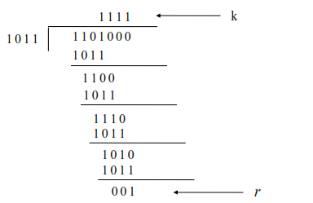
Cyclic Redundancy Check (CRC)
x-or rules

Slide 6
Cyclic Redundancy Check (CRC)
Consider the case where k=1101.
Hence we have to divide 1101000 (i.e. k appended by 3 zeros) by 1011, which produces the remainder r=001, so that the bit frame (k+r) =1101001 is actually being transmitted through the communication channel.
At the receiving end, if the received number, i.e.,1101001 is divided by the same generator polynomial 1011 to get the remainder as 000, it can be assumed that the data is free of errors.

Slide 7
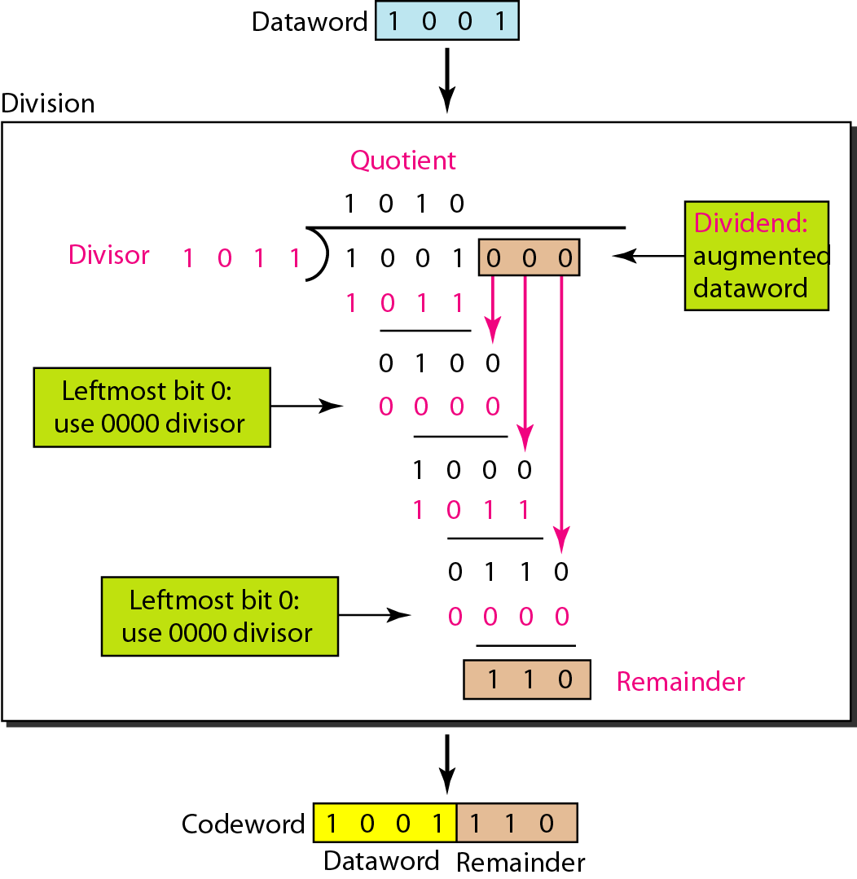
CRC encoder

Slide 8
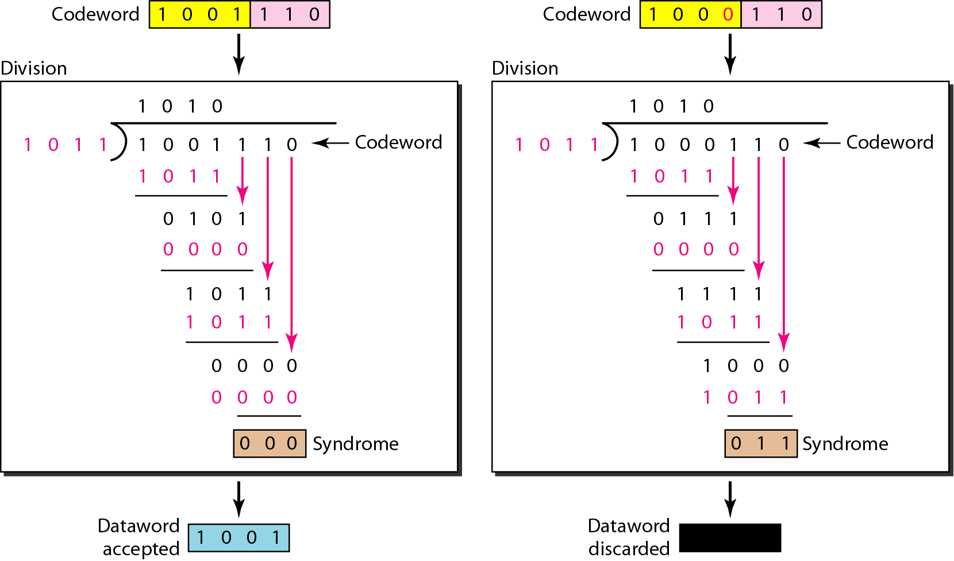
CRC decoder for two cases

Slide 9
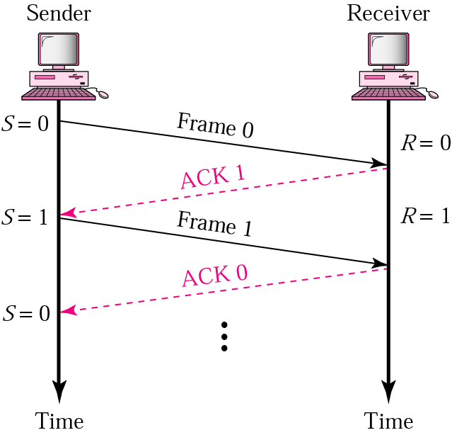
Stop-and-Wait : Normal Operation
Sender keeps a copy of the last frame until it receives an acknowledgement.
For identification, both data frames and acknowledgements (ACK) frames are numbered alternatively 0 and 1.
Sender has a control variable (S) that holds the number of the recently sent frame. (0 or 1)
Receiver has a control variable R that holds the number of the next frame expected (0 or 1).
Sender starts a timer when it sends a frame. If an ACK is not received within a allocated time period, the sender assumes that the frame was lost or damaged and resends it
Receiver send only positive ACK if the frame is intact.
ACK number always defines the number of the next expected frame

Slide 10
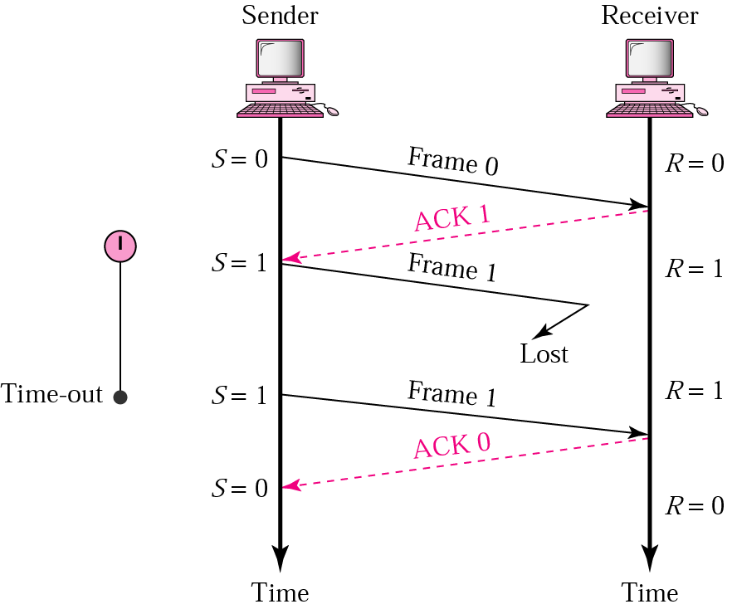
Stop-and-Wait ARQ: lost frame
When a receiver does not receives a frame, it keeps its previous value of R.
After the timer at the sender expires, another copy of frame 1 is sent.

Slide 11
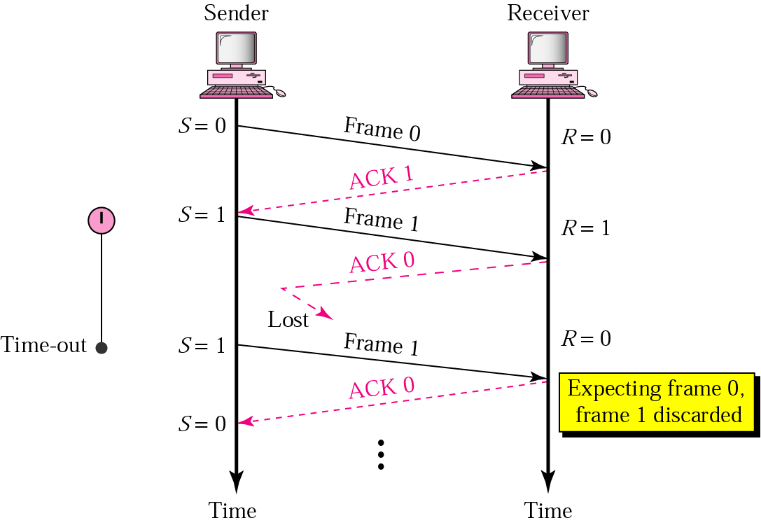
Stop-and-Wait: lost ACK frame
Receiver has already received frame 1 and expecting to receive frame 0 (R=0). Therefore it discards the second copy of frame 1.

Slide 12
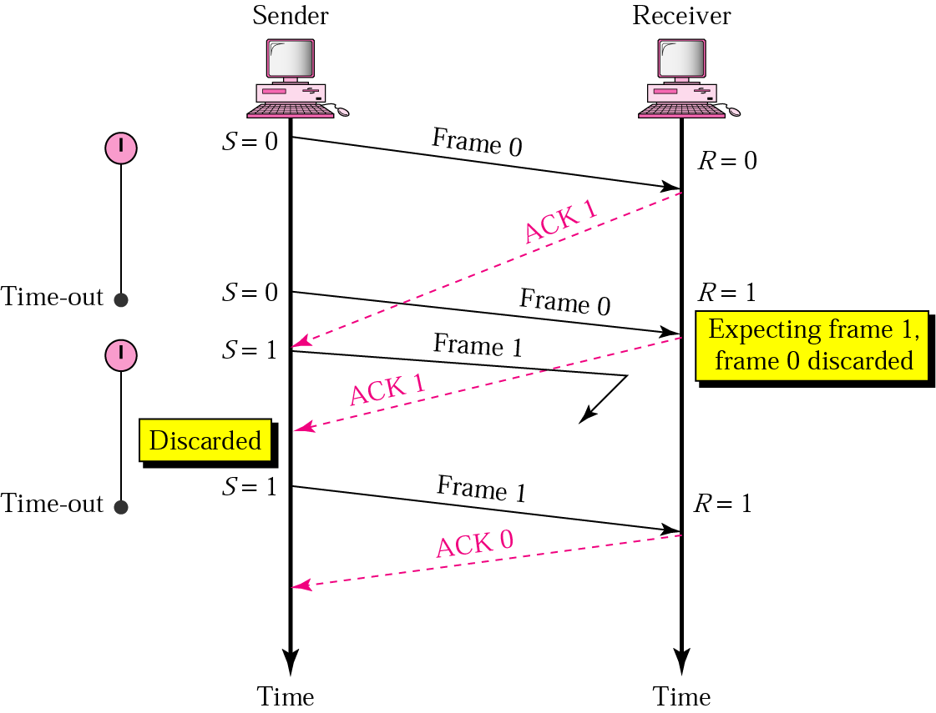
Stop-and-Wait: delayed ACK frame
The ACK can be delayed at the receiver or due to some problem
It is received after the timer for frame 0 has expired.
Sender retransmitted a copy of frame 0. However, R =1 means receiver expects to see frame 1. Receiver discards the duplicate frame 0.
Sender receives 2 ACKs, it discards the second ACK.

